Slide 1


Why Py?
motivation for the beyond
FEEDBACK: strawpoll.me/16516525

Slide 2

Agenda
Preamble
- Level-Up
- About Me (and You!)
Content
- History
- Overview
- Procedural Programming & Scripting
- Data Science & Visualization
- Special Mentions (WebDev/Hardware)
- Wrap-Up + Resources

Slide 3


LEVEL-UP (430 XP)
- Get ‘XP’ for doing stuff.
- Win stuff using this ‘XP’
- 750 Phone Stand
- 1750 Mini-Speaker
- 3000 Bamboo Pencils & Pen
- 4500+ Entered into a give-away
for fancy stuff.

Slide 4
Section 0:
ABOUT ME
Know what you’re getting into

Slide 5

I Am...
Raymond Tran
3rd Yr. Computer Science Student
VP Academic Events for CSUS 18/19

Slide 6
I Am...
Raymond Tran
3rd Yr. Computer Science Student
VP Academic Events for CSUS 18/19
Python Newbie

Slide 7
I Am...
Raymond Tran
3rd Yr. Computer Science Student
VP Academic Events for CSUS 18/19
Python Newbie
Scared of C

Slide 8
I Am...
Raymond Tran
3rd Yr. Computer Science Student
VP Academic Events for CSUS 18/19
Python Newbie
Scared of C
Terrible at Formal Logic/Proofs

Slide 9
I Am...
Raymond Tran
3rd Yr. Computer Science Student
VP Academic Events for CSUS 18/19
Python Newbie
Scared of C
Terrible at Formal Logic/Proofs
Knows nothing about web-dev.

Slide 10
I Am...
Raymond Tran
3rd Yr. Computer Science Student
VP Academic Events for CSUS 18/19
Python Newbie
Scared of C
Terrible at Formal Logic/Proofs
Knows nothing about web-dev.
Most qualified to do this presentation!

Slide 11
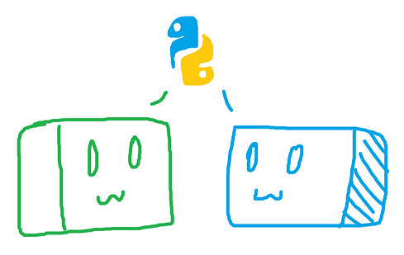
You hopefully are...
A Python Newbie
Computer Science Student
A Member of CSUS 18/19

Slide 12
You hopefully are...
A Python Newbie
Computer Science Student
A Member of CSUS 18/19
(Or else I’m gonna disappoint ya.)

Slide 13
Section 1:
HISTORY
Going from hobby to global

Slide 14
History
Initial Years

Slide 15

History
Initial Years
- Created by Guido van Rossum.
Image from his Twitter: @gvanrossum

Slide 16
History
Initial Years
- Created by Guido van Rossum.
- Inspired by the ABC language.
Image from his Twitter: @gvanrossum

Slide 17
History
Initial Years
- Created by Guido van Rossum.
- Inspired by the ABC language.
- Emphasis on readability.
Image from his Twitter: @gvanrossum

Slide 18
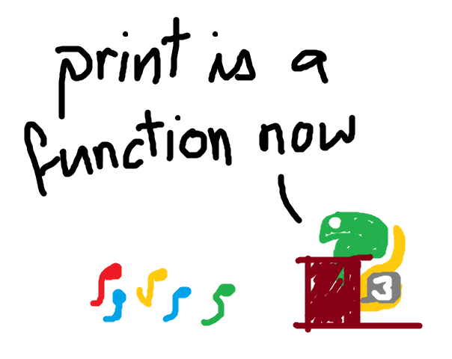
History
From Python2 to Python3.
- Referred to as Python3000 or Py3K.

Slide 19
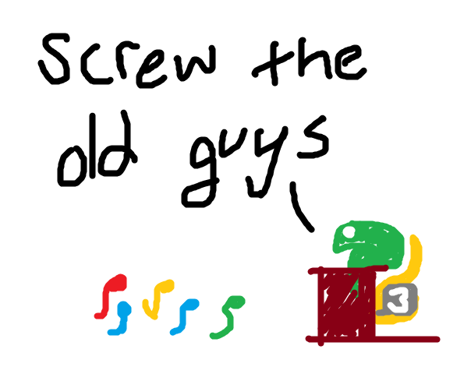
History
From Python2 to Python3.
- Referred to as Python3000 or Py3K.
- Purposefully backwards incompatible.

Slide 20
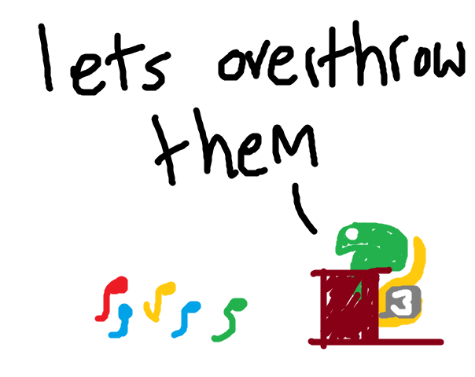
History
From Python2 to Python3.
- Referred to as Python3000 or Py3K.
- Purposefully backwards incompatible.
- Removal of deprecated functions.

Slide 21
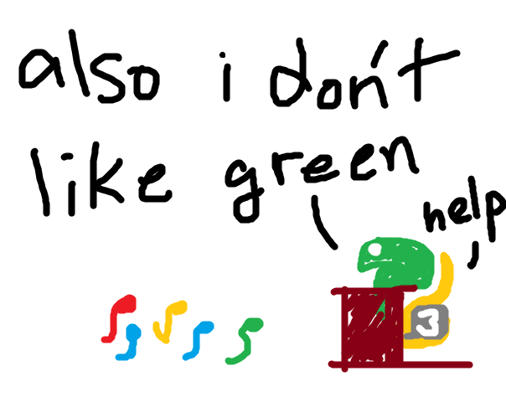
History
From Python2 to Python3.
- Referred to as Python3000 or Py3K.
- Purposefully backwards incompatible.
- Removal of deprecated functions.
- End of Life for 2.7 slated for 2020.

Slide 22
History
Present Time
*According to Stack Overflow Dev Survey 2018

Slide 23
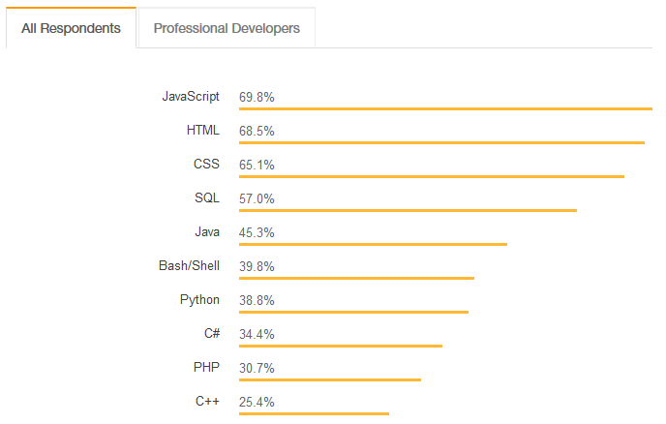
History
Present Time
- Top 10 languages used in 2018.*
*According to Stack Overflow Dev Survey 2018

Slide 24
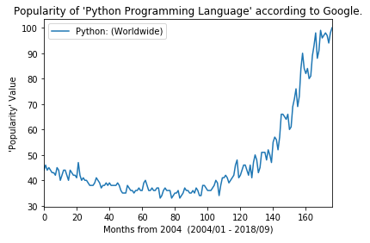
History
Present Time
- Top 10 languages used in 2018.*
- Exponential growth in use.
*According to Stack Overflow Dev Survey 2018

Slide 25
History
Present Time
- Top 10 languages used in 2018.*
- Exponential growth in use.
- Massive library ecosystem.
*According to Stack Overflow Dev Survey 2018

Slide 26
Section 2:
OVERVIEW
Learn to identify your snakes

Slide 27
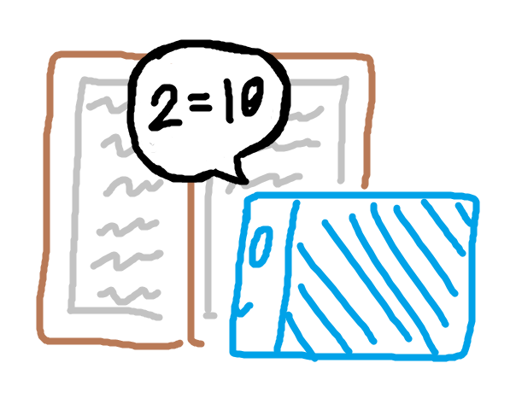
Overview
Python is Interpreted
- Python code is ‘compiled’ line-by-line by the compiler.
- Allows it to be dynamically typed.

Slide 28
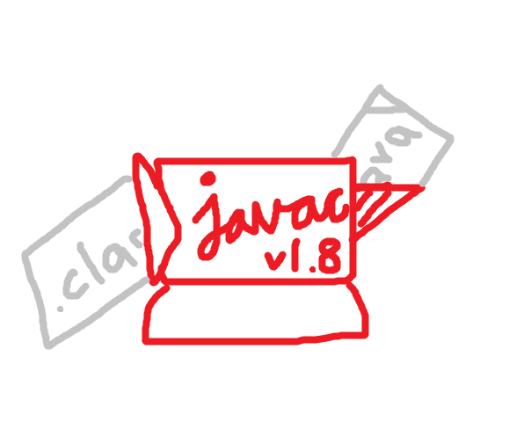
Overview
Python is Interpreted vs. Compiled
- Python code is ‘compiled’ line-by-line by the compiler.
- Allows it to be dynamically typed.
- Java code is compiled first into a bytecode for the JVM.
- A longer pre-use compilation to make execution faster.

Slide 29
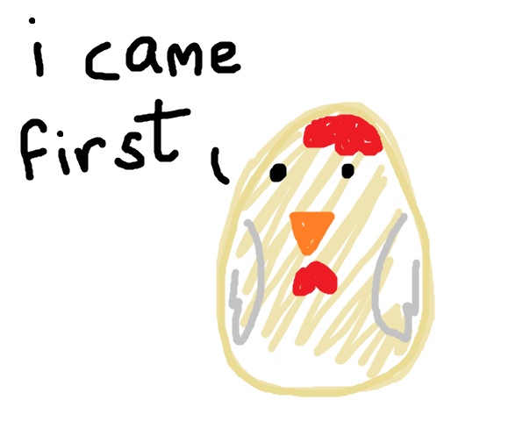
Overview
Python is Dynamically Typed
Python:
x = 10
x = “Dynamically typed.”

Slide 30
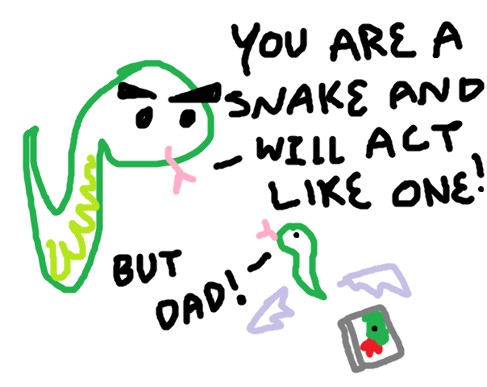
Overview
Python is Dynamically Typed vs. Statically Typed
Python:
x = 10
x = “Dynamically typed.”
Java:
int x = 10;
String y = “Statically typed.”);
IN AN ALTERNATE UNIVERSE WHERE
PYTHON IS STATICALLY TYPED

Slide 31
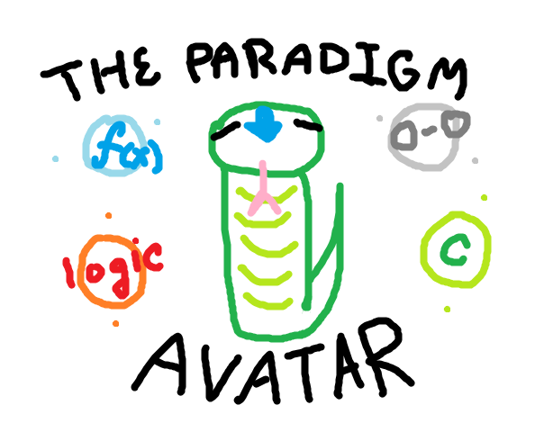
Overview
Python also...
- Supports multiple paradigms.
(Ex. Object-oriented, functional, procedural, imperatively, etc.)

Slide 32
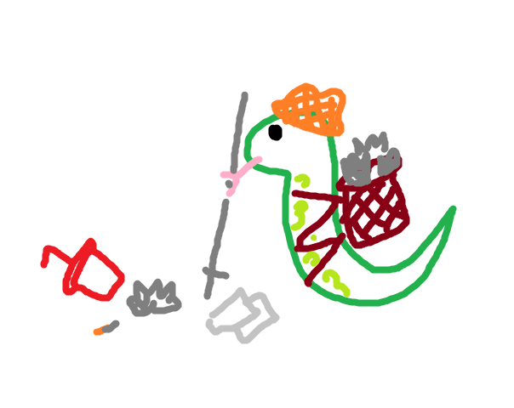
Overview
Python also...
- Supports multiple paradigms.
(Ex. Object-oriented, functional, procedural, imperatively, etc.)
- Has automatic memory-management.
(Ex. No need to manually assign RAM, or de-reference dangling pointers.)

Slide 33

Overview
Python also...
- Supports multiple paradigms.
(Ex. Object-oriented, functional, procedural, imperatively, etc.)
- Has automatic memory-management.
(Ex. No need to manually assign RAM, or de-reference dangling pointers.)
- Uses significant whitespace.
(Ex. Tabs/Spaces matter. Curly brackets are used in formatting/dictionaries.)

Slide 34
Section 3:
PROCEDURAL
PROGRAMMING
Automate the Boring Stuff

Slide 35
Definition
Procedural Programming is…

Slide 36

Definition
Procedural Programming is…
- Writing code from a solution-first perspective.

Slide 37
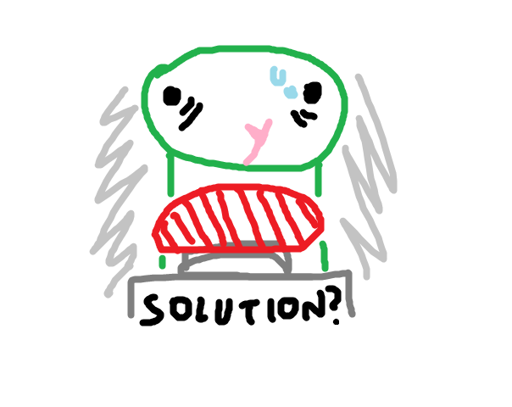
Definition
Procedural Programming is…
- Writing code from a solution-first perspective.
- Doing stuff with functions, subroutines, etc.

Slide 38
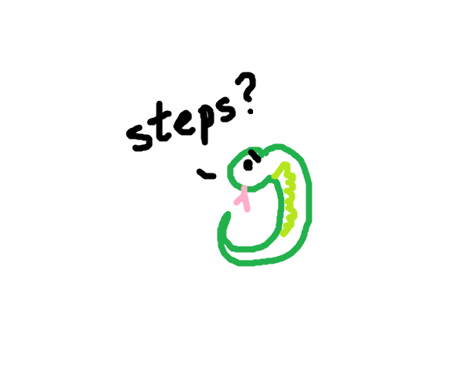
Definition
Procedural Programming is…
- Writing code from a solution-first perspective.
- Doing stuff with functions, subroutines, etc.
- Going step-by-step to get a solution.

Slide 39

Definition
Procedural Programming is…
- Writing code from a solution-first perspective.
- Doing stuff with functions, subroutines, etc.
- Going step-by-step to get a solution.
- Not Object-Oriented programming.

Slide 40
Example A
youtube-dl

Slide 41

Example A
youtube-dl
- A command-line program.
http://rg3.github.io/youtube-dl/

Slide 42
Example A
youtube-dl
- A command-line program.
- Downloads video content.
http://rg3.github.io/youtube-dl/

Slide 43
Example A
youtube-dl
- A command-line program.
- Downloads video content.
- Highly customizable.
http://rg3.github.io/youtube-dl/

Slide 44
Example A
youtube-dl
- A command-line program.
- Downloads video content.
- Highly customizable.
- Callable from other programs.
http://rg3.github.io/youtube-dl/

Slide 45
Example A
youtube-dl
- A command-line program.
- Downloads video content.
- Highly customizable.
- Callable from other programs.
- Public domain!
http://rg3.github.io/youtube-dl/

Slide 46
Example A - Downloading via CMD
youtube-dl https://www.youtube.com/watch?v=D3mK5wVws3s
oh ya ray show that other thing on their website -ray

Slide 47
Command lines not your thing?

Slide 48
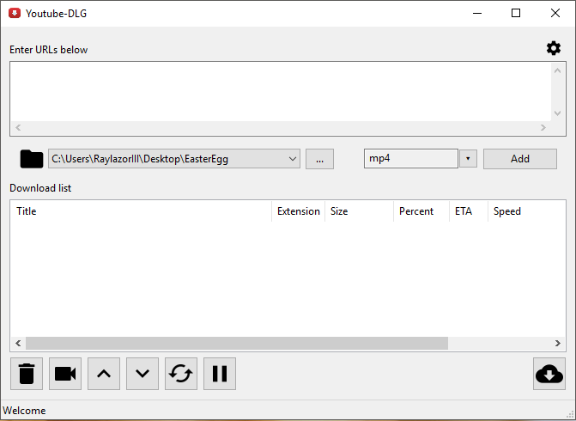
Example B
youtube-dl GUI
- Also written in Python!
- Clean, cross-platform GUI.
- Runs in executables.
- Also public domain!
github.com/MrS0m30n3/youtube-dl-gui

Slide 49
Example B - Downloading via GUI
https://www.youtube.com/watch?v=5aC4akD6RUk

Slide 50
Example C
Finance Tracker
Finance Checker’s readme.txt

Slide 51
Example C
Finance Tracker
- Tracks...finances?
Finance Checker’s readme.txt

Slide 52
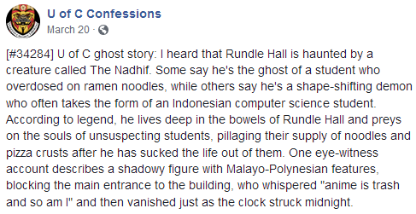
Example C
Finance Tracker
- Tracks...finances?
- Created by our Interim VP PR, Nadhif.
facebook.com/UofCConfess/posts/1624664134277070

Slide 53
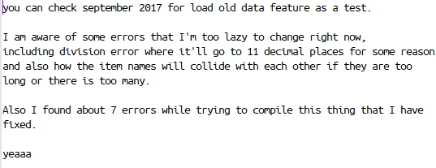
Example C
Finance Tracker
- Tracks...finances?
- Created by our Interim VP PR, Nadhif.
- ...when he was a kid.
Finance Checker’s readme.txt

Slide 54
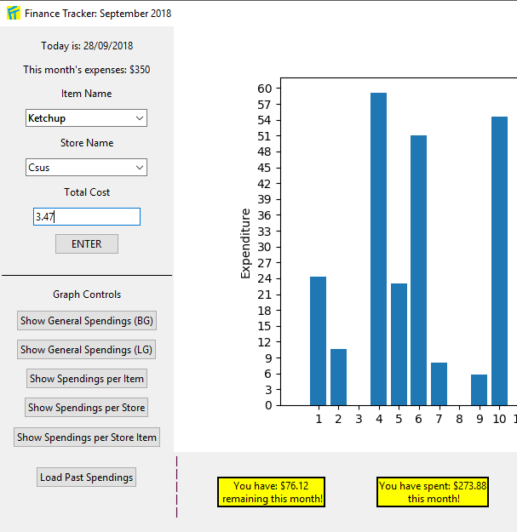
Example C
Finance Tracker
- Tracks...finances?
- Created by our Interim VP PR, Nadhif.
- ...when he was a kid.
- Executable made with cx_Freeze

Slide 55
Example C - Finance Tracker
Try Accessing Files
Try Putting in Negatives
Show Spendings per Item
Anyone can make something if they try hard enough!

Slide 56
Section 4:
DATA SCIENCE
Visualizing Data with Pandas, Seaborn, and more

Slide 57
Definition
Data Science is about…

Slide 58

Definition
Data Science is about…
- Data Collection

Slide 59
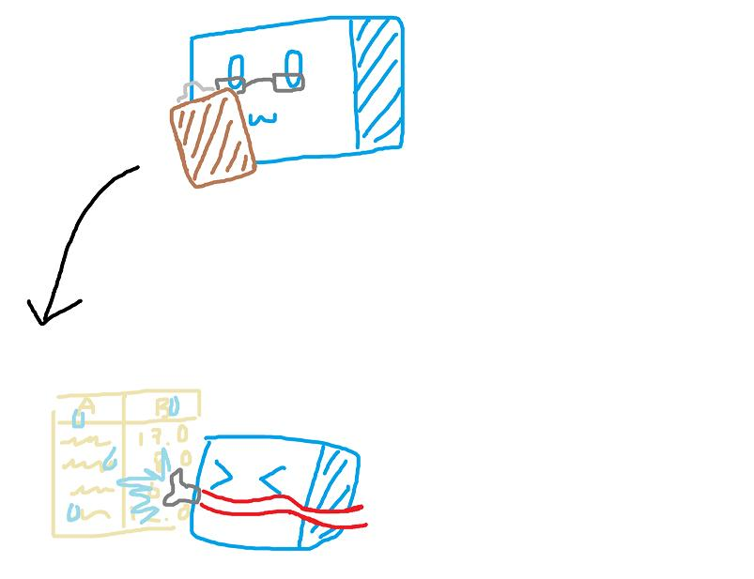
Definition
Data Science is about…
- Data Collection
- Data Cleaning

Slide 60
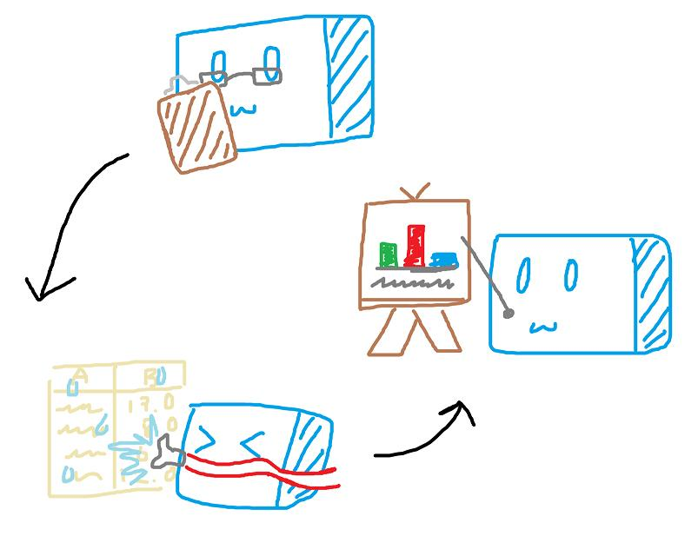
Definition
Data Science is about…
- Data Collection
- Data Cleaning
- Data Analysis

Slide 61
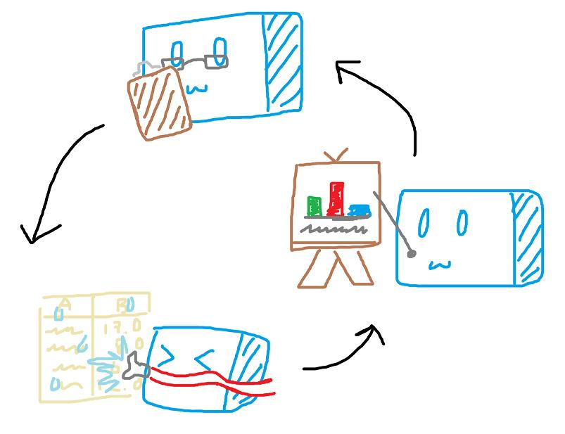
Definition
Data Science is about…
- Data Collection
- Data Cleaning
- Data Analysis
- Repeat!

Slide 62

Overview
The R Programming Language
r-project.org

Slide 63
Overview
The R Programming Language
- Appeared in 1993.
r-project.org

Slide 64
Overview
The R Programming Language
- Appeared in 1993.
- Still widely used.
r-project.org

Slide 65
Overview
The R Programming Language
- Appeared in 1993.
- Still widely used.
- Reliable and time-tested.
r-project.org

Slide 66
Overview
The R Programming Language
- Appeared in 1993.
- Still widely used.
- Reliable and time-tested.
- Open source.
r-project.org

Slide 67

Overview
The Python Programming Language
python.org

Slide 68
Overview
The Python Programming Language
- Growing due to its simplicity and ease.
python.org

Slide 69
Overview
The Python Programming Language
- Growing due to its simplicity and ease.
- Introduction of Pandas, Numpy, etc.
python.org

Slide 70
Overview
The Python Programming Language
- Growing due to its simplicity and ease.
- Introduction of Pandas, Numpy, etc.
- Lots of support with Anaconda Navigator.
python.org

Slide 71
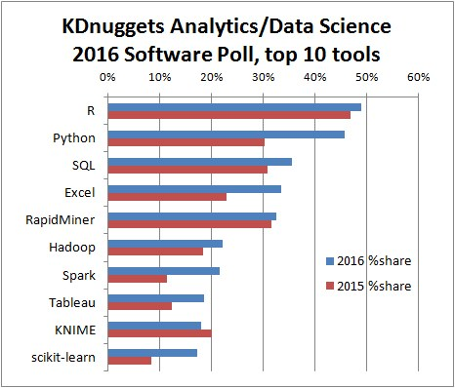
kdnuggets.com/2016/06/r-python-top-analytics-data-mining-data-science-software.html

Slide 72
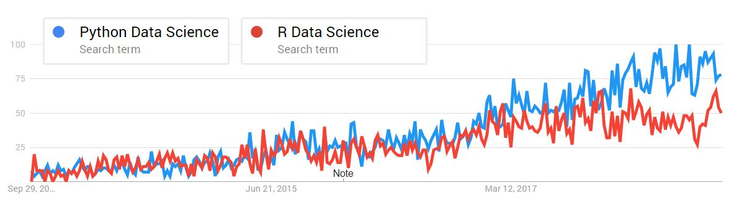
https://goo.gl/UUaEUy
(Python Data Science vs. R Data Science in the U.S. over a 5-year period.)

Slide 73

Example A
Anaconda Navigator
anaconda.org/anaconda/anaconda-navigator

Slide 74
Example A
Anaconda Navigator
- A free and open-source distribution.
anaconda.org/anaconda/anaconda-navigator

Slide 75
Example A
Anaconda Navigator
- A free and open-source distribution.
- Contains packages for Python and R.
anaconda.org/anaconda/anaconda-navigator

Slide 76
Example A
Anaconda Navigator
- A free and open-source distribution.
- Contains packages for Python and R.
- Emphasis on Data Science and Machine Learning.
anaconda.org/anaconda/anaconda-navigator

Slide 77
Example A - 599.87 Datathons
Anaconda Navigator:
- Datathon 2 (Better Life Index)

Slide 78
Example B
SnekChek

Slide 79
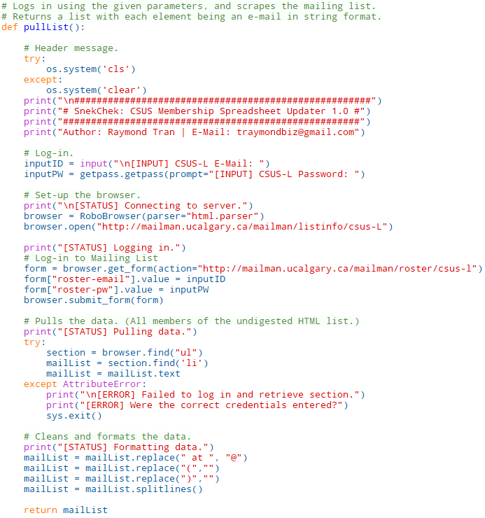
Example B
SnekChek
- Script written for CSUS.

Slide 80
Example B
SnekChek
- Script written for CSUS.
- Pulls names from mailing list.

Slide 81
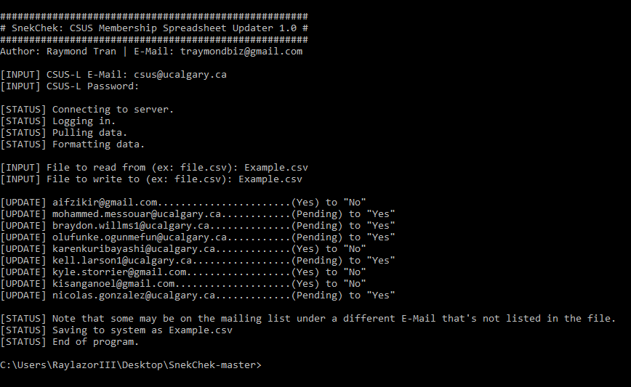
Example B
SnekChek
- Script written for CSUS.
- Pulls names from mailing list.
- Compares it against spreadsheet.

Slide 82
Example B
SnekChek
- Script written for CSUS.
- Pulls names from mailing list.
- Compares it against spreadsheet.
- Updates spreadsheet accordingly.

Slide 83
Example B - Mailing List
http://mailman.ucalgary.ca/mailman/listinfo/csus-L

Slide 84
Resources
Computer Science Courses
CPSC 583
Introduction to Information Visualization
CPSC 599.87
Visualization and Analytics
ucalgary.ca/pubs/calendar/current/computer-science.html
https://www.ucalgary.ca/cpsc/
Data Science Courses
DATA 201
Thinking with Data
DATA 305
Computation Statistical Modelling
DATA 311
Data Processing and Storage
ucalgary.ca/pubs/calendar/current/data-science.html
ucalgary.ca/science/data-science

Slide 85
Section 5:
SPECIAL MENTIONS
Web-development, Hardware playground

Slide 86

Yeah, I don’t know anything about
web development.

Slide 87
Or much about hardware, either.

Slide 88


Slide 89
Overview
Two Popular Frameworks:
r-project.org

Slide 90

Overview
Two Popular Frameworks:
- The Flask Microframework
flask.pocoo.org

Slide 91

Overview
Two Popular Frameworks:
- The Flask Microframework
- Django
djangoproject.com

Slide 92
Flask
The Flask Microframework...
flask.pocoo.org

Slide 93
Flask
The Flask Microframework...
- Originally an April Fool’s joke.
flask.pocoo.org

Slide 94
Flask
The Flask Microframework...
- Originally an April Fool’s joke.
- Is designed to be simple and light.
flask.pocoo.org

Slide 95
Flask
The Flask Microframework...
- Originally an April Fool’s joke.
- Is designed to be simple and light.
- Is syntactically simple with little boilerplate code.
flask.pocoo.org

Slide 96
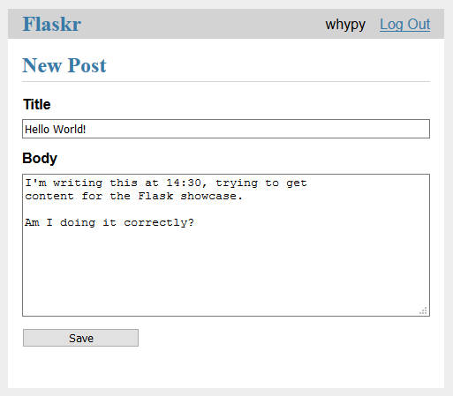
github.com/pallets/flask-website

Slide 97
Django
The Django Framework...

Slide 98
Django
The Django Framework...
- Focuses on easy, reusable code.
djangoproject.com

Slide 99
Django
The Django Framework...
- Focuses on easy, reusable code.
- Emphasis on simple database-driven websites.
djangoproject.com

Slide 100
Django
The Django Framework...
- Focuses on easy, reusable code.
- Emphasis on simple database-driven websites.
- Used by PBS, Instagram, Mozilla, etc.
djangoproject.com

Slide 101
Overview
Python in Hardware

Slide 102

Overview
Python in Hardware
- Python code typically jives well with Raspberry Pis
(Arduinos are usually done in the C language.)
www.raspberrypi.org

Slide 103
Overview
Python in Hardware
- Python code typically jives well with Raspberry Pis
(Arduinos are usually done in the C language.)
- Many projects schematics are available online.
www.raspberrypi.org

Slide 104
Overview
Python in Hardware
- Python code typically jives well with Raspberry Pis
(Arduinos are usually done in the C language.)
- Many projects schematics are available online.
- CPSC 359 introduces you to RPi3-Bs
www.raspberrypi.org

Slide 105
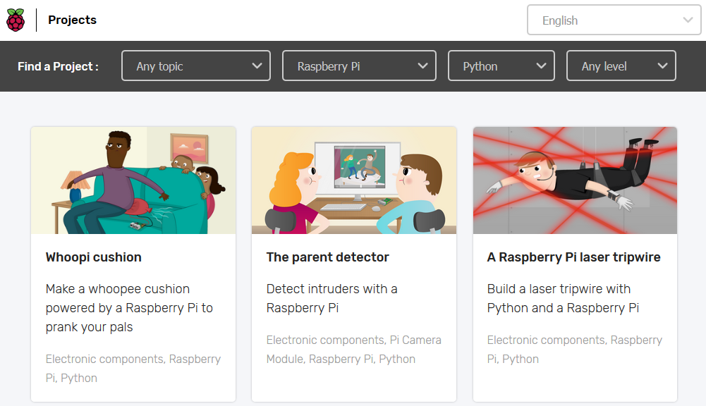
projects.raspberrypi.org/en

Slide 106
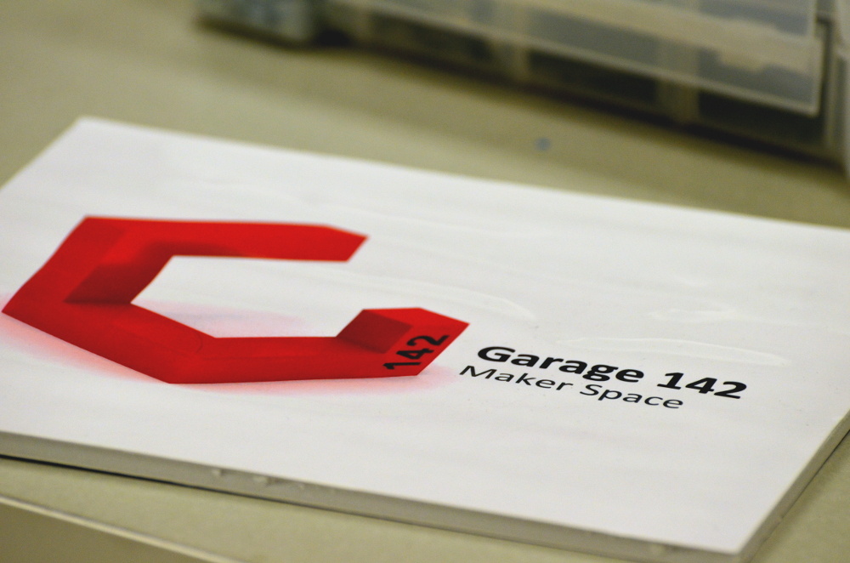
GARAGE (MS 142)
- Place to plan and implement projects.
- 3D Printing Software
- Old tech, bits & pieces available.
- Requires safety training. (See E-Mail)
- Great place to work on RPis!
joshua.horacsek@ucalgary.ca
garage142.cpsc.ucalgary.ca

Slide 107

HACK-A-THONS
- Events to learn new skills and challenge your current ones!
- Make new friends and compete to win first place!
- Usually involves inventing something fun with hardware.
- CSUS hosts one every year during the Winter-semester break.

Slide 108
RESOURCES
Web-Development
CPSC 441
Computer Networks (Theory of the Internet)
SENG 513
Web-Based Systems
Flask Documentation
A beginner friendly, step-by-step intro to Flask.
flask.pocoo.org/docs/1.0
Django Documentation
In-depth, thorough documentation/tutorials.
docs.djangoproject.com/en/2.1
ucalgary.ca/pubs/calendar/current/computer-science.html
https://www.ucalgary.ca/cpsc/
Hardware
CPSC 359
Computing Machinery II
CPSC 581
Human-Computer Interactions II
https://www.ucalgary.ca/pubs/calendar/current/software-engineering.html

Slide 109
Section 6:
LEARN MORE
Learn yourself smarter

Slide 110
RESOURCES
Python Resources
Dive Into Python 3
Fast-track Python with examples. Great refresher.
www.diveintopython3.net

Slide 111
RESOURCES
Python Resources
Dive Into Python 3
Fast-track Python with examples. Great refresher.
www.diveintopython3.net
Automate the Boring Stuff
A thorough guide for beginners by Al Sweigart.
www.automatetheboringstuff.com

Slide 112
RESOURCES
Python Resources
Dive Into Python 3
Fast-track Python with examples. Great refresher.
www.diveintopython3.net
Automate the Boring Stuff
A thorough guide for beginners by Al Sweigart.
www.automatetheboringstuff.com
Lynda.com
An online learning website.
Entirely free for Calgary Library Card holders!
www.lynda.com/

Slide 113
RESOURCES
Python Resources
Dive Into Python 3
Fast-track Python with examples. Great refresher.
www.diveintopython3.net
Automate the Boring Stuff
A thorough guide for beginners by Al Sweigart.
www.automatetheboringstuff.com
Lynda.com
An online learning website.
Entirely free for Calgary Library Card holders!
www.lynda.com/
Specialty Resources
Sentdex’s YouTube Channel
Advanced Python projects by an expert.
www.youtube.com/sentdex

Slide 114
RESOURCES
Python Resources
Dive Into Python 3
Fast-track Python with examples. Great refresher.
www.diveintopython3.net
Automate the Boring Stuff
A thorough guide for beginners by Al Sweigart.
www.automatetheboringstuff.com
Lynda.com
An online learning website.
Entirely free for Calgary Library Card holders!
www.lynda.com/
Specialty Resources
Sentdex’s YouTube Channel
Advanced Python projects by an expert.
www.youtube.com/sentdex
Anaconda Starter Guide
A sheet linking various Data Science packages.
go2.anaconda.com/tCWT161WXB02l00RN00002A

Slide 115
RESOURCES
Python Resources
Dive Into Python 3
Fast-track Python with examples. Great refresher.
www.diveintopython3.net
Automate the Boring Stuff
A thorough guide for beginners by Al Sweigart.
www.automatetheboringstuff.com
Lynda.com
An online learning website.
Entirely free for Calgary Library Card holders!
www.lynda.com/
Specialty Resources
Sentdex’s YouTube Channel
Advanced Python projects by an expert.
www.youtube.com/sentdex
Anaconda Starter Guide
A sheet linking various Data Science packages.
go2.anaconda.com/tCWT161WXB02l00RN00002A
Raspberry Pi Projects
A giant collection of projects for your RPi3.
projects.raspberrypi.org/en

Slide 116
RESOURCES
Python Resources
Dive Into Python 3
Fast-track Python with examples by Mark Pilgrim.
www.diveintopython3.net
Automate the Boring Stuff
A thorough guide for beginners by Al Sweigart.
www.automatetheboringstuff.com
Lynda.com
An online learning website.
Entirely free for Calgary Library Card holders!
www.lynda.com/
Specialty Resources
Sentdex’s YouTube Channel
Advanced Python projects by an expert.
www.youtube.com/sentdex
Anaconda Starter Guide
A sheet linking various Data Science packages.
go2.anaconda.com/tCWT161WXB02l00RN00002A

Slide 117
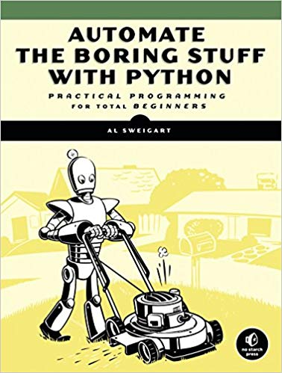
Automate the Boring Stuff
- Written by Al Sweigart
- Uses plain english and examples.
- Designed for new programmers.
- Goes in-depth with ‘automating’ workloads in later chapters.
- Entirely free on the website!
automatetheboringstuff.com

Slide 118
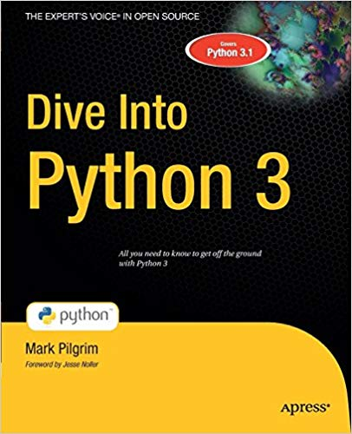
Dive into Python 3
- Written by Mark Pilgrim
- Showcases and dissects useful code.
- Excellent for returning programmers.
- Dives into advanced topics in an approachable manner.
- Great for learning the capabilities of the language. (Scripting, Networks, Testing, etc.)
- Entirely free on the website!
diveintopython3.net

Slide 119
End of
Presentation
FEEDBACK: strawpoll.me/16516525
GITHUB: github.com/traymondbiz/WhyPy

